Slide 1


Intro to Reverse Engineering
OWASP
Open Web Application
Security Project
By: Tsvetelin (Vincent) Choranov
Notes:
Introduce yourself
Mention CTFs
What is Reverse Engineering all about

Slide 2
Schedule
9:00 – 10:30 am
C Refresher
Data Types
Process Structure and Virtual Memory
10:30 – 10:45 am
Break
10:45 – Noon
X86 Registers
Stack
Noon – 1:00 pm
Lunch
1:00 – 2:30 pm
Assembly Instructions
Calling Conventions
2:30 – 2:45 pm
Break
2:45 – 4:30 pm
Debuggers Disassemblers and Decompilers

Slide 3
C refresher - Control Flow
If statement
If-else
While / Until
For loops
Switch/Case statements ( Jump tables )

Slide 4
C refresher - Control Flow
Pseudo-code – if statement
if ( You are hungry ) {
Find food
while ( Found food is not good ) {
Find something else to eat
}
Eat food
} else {
Go play }

Slide 5
C refresher - Control Flow
Pseudo-code – else statement
if ( You are hungry ) {
Find food
while ( Found food is not good ) {
Find something else to eat
}
Eat food
} else {
Go play }

Slide 6
C refresher - Control Flow
Pseudo-code – while statement
if ( You are hungry ) {
Find food
while ( Found food is not good ) {
Find something else to eat
}
Eat food
} else {
Go play }

Slide 7
C refresher - Control Flow
Pseudo-code – for loop
for ( int i = 0 ; i < 10 ; i++ ) {
do something
}
Key points:
Identify the initialization of the counter variable
Identify the limit
Identify the increment

Slide 8

C refresher - Control Flow
Pseudo-code – switch/case statement
my_int = 2 ; my_int = 2 ;
switch ( my_int ) {
case 1: if ( my_int == 1 ) {
do something do something
break }
case 2: else if ( my_int == 2 ) {
do something do something
break }
default: else {
do something do something
} }

Slide 9


C refresher - Control Flow
Pseudo-code – switch/case statement sometimes produce jump tables

Slide 10
C refresher - Variables
Local
Global
Initialized / Uninitialized
Signed / Unsigned Integer
Pointer
Structure

Slide 11
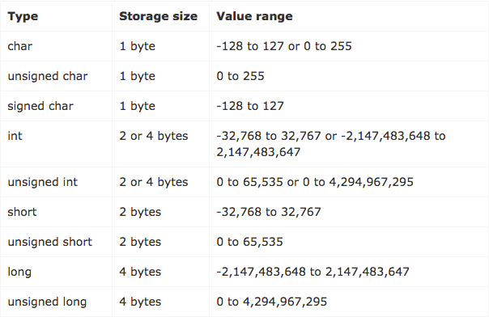
C refresher - Data Types

Slide 12
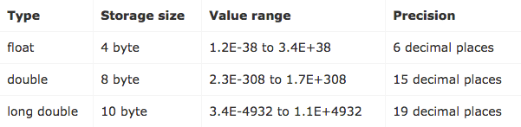
C refresher - Data Types
Notations:
half a word = 2 bytes
word = 2/4 bytes
dword = 4 bytes
qword/giant = 8 bytes

Slide 13
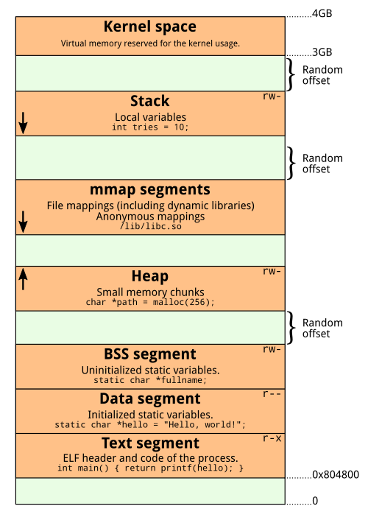
Virtual Memory
Notes:
15 min break

Slide 14
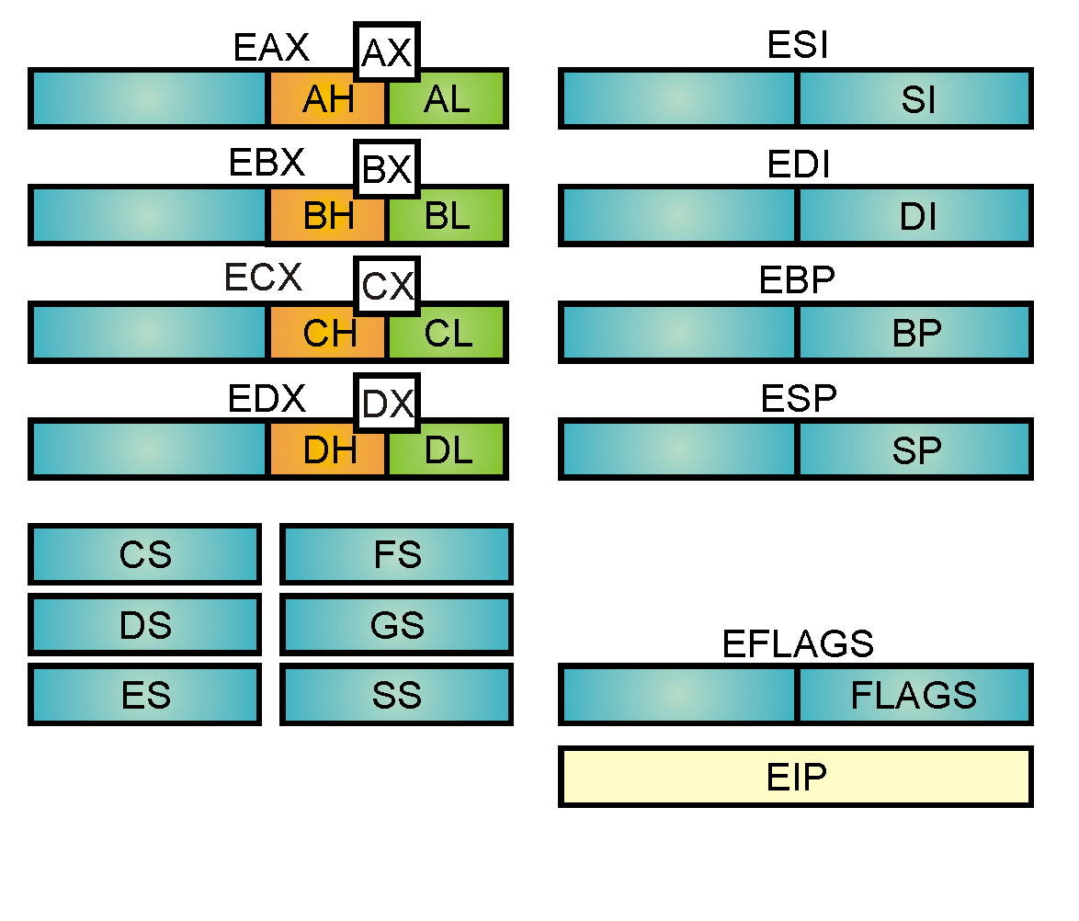
x86 CPU Registers

Slide 15
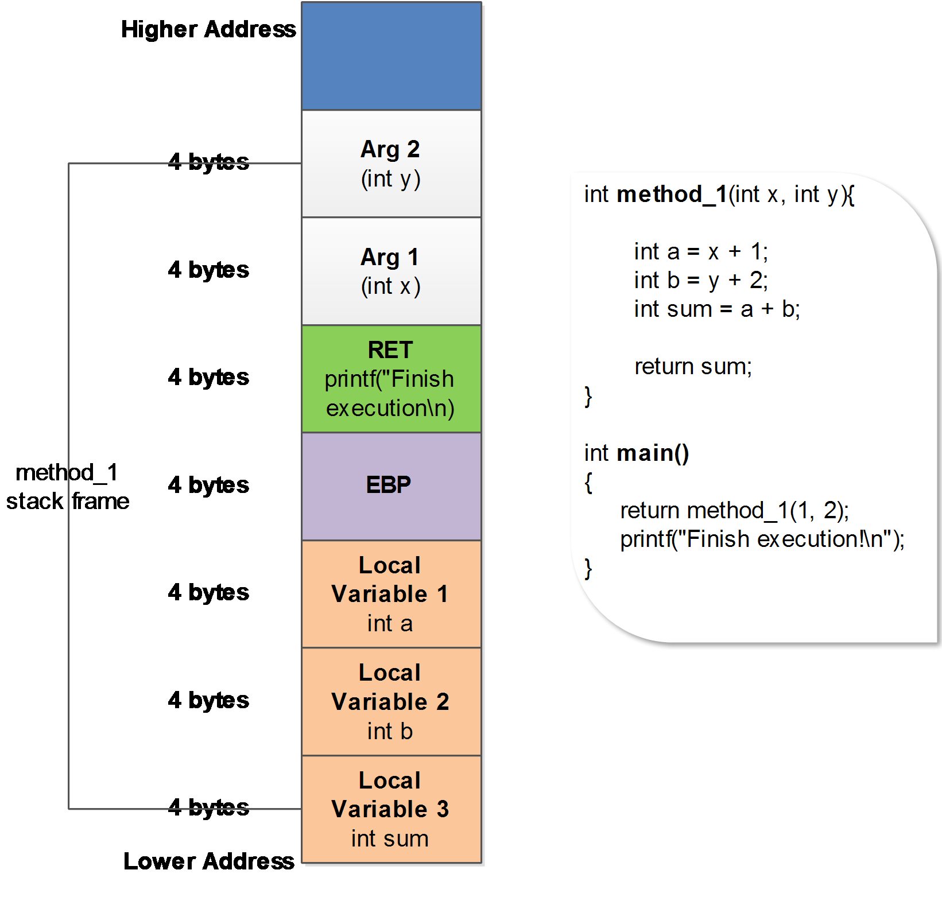
Stack and Heap
Notes:
Last-In-First-Out
Local variables
Arguments
Back trace (keeps track of which functions were called before that)

Slide 16
Assembly
Endianness
Big-endian and little-endian are terms that describe the order in which a sequence of bytes are stored in computer memory. Big-endian is an order in which the "big end" (most significant value in the sequence) is stored first (at the lowest storage address).

Slide 17
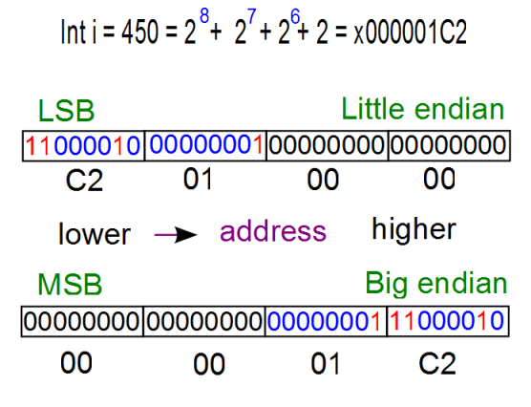
Assembly
Endianness

Slide 18
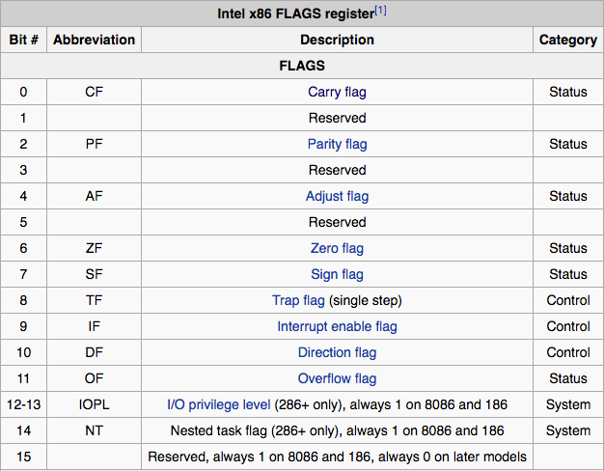
EFLAGS Register
Notes:
For now we only care about two:
Zero Flag - its set if the result of some instruction is zero, otherwise it’s cleared
Sign Flag - Set equal to the MSB of the result, which is the sign bit of a signed integer (0 indicates positive value, 1 indicates negative value)

Slide 19
Assembly
NOP
No operation
0x90
Used for alignment
In exploitation used for NOP-sleds

Slide 20
Assembly
PUSH
Pushes data to the stack
Size of data is word, dword, qword
Data can be an immediate value or register
Decrements ESP

Slide 21
Assembly
POP
Pops a value from the stack to a register
Increments ESP

Slide 22
Assembly
MOV
Move operation
Moves:
register to register
memory to register
register to memory
immediate to register
immediate to memory
memory to memory
MOV EAX, [EBX]
Notes:
- Explain about square brackets mean dereference

Slide 23
Assembly
SUB
Subtract operation
Source can be memory, immediate or register
Destination can be memory or register
Source and Destination can NOT be memory
It can be used to evaluate an expression
Influences the following EFLAGS
OF, SF, ZF, AF, PF and CF

Slide 24
Assembly
ADD
Addition operation
Source can be memory, immediate or register
Destination can be memory or register
Source and Destination can NOT be memory
It can be used to evaluate an expression
Influences the following EFLAGS
OF, SF, ZF, AF, PF and CF

Slide 25
Assembly
CALL
Execute a procedure
It pushes the address of the next instruction after the call to the stack, so execution can be restored once the called procedure returns
Changes EIP to the address of the called procedure

Slide 26
Assembly
LEAVE
Restores the previous stack frame
Essentially does:
MOV ESP, EBP
POP EBP

Slide 27
Assembly
RET
Return from a procedure
RET == POP EIP
POP increments ESP
Also seen as RET 0x?? which pops into EIP and increments ESP by 0x??

Slide 28
Assembly
NOP
PUSH
POP
MOV
SUB
ADD
RET
LEAVE
CALL

Slide 29
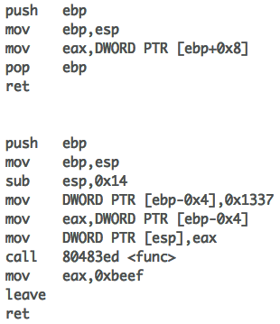
Assembly
Example
int func(int x){
return x;
}
int main(void){
int x = 0x1337;
func(x);
return 0xbeef;
}

Slide 30
Assembly
Example
Function Prologue…..............................

Slide 31
Assembly
Example
Function Epilogue…..............................

Slide 32
Assembly
Example
EBP holds the base
address
of the previous
stack frame
ESP now points here ->
saves EBP

Slide 33
Assembly
Example
ESP is COPIED to EBP.
EBP is now the base of
our new stack frame.
Which is the stack frame for main()
ESP now points here ->
saved EBP

Slide 34
Assembly
Example
EBP ->
saved EBP
ESP ->
Notes:
This is main()’s current stack frame
All the local variables will be placed between this virtual address space, between EBP and ESP
EBP is referred as THE BASE POINTER because all the local variables will be referenced by an offset from EBP.

Slide 35
Assembly
Example
EBP ->
saved EBP
0x1337
ESP ->

Slide 36
Assembly
Example
EBP ->
saved EBP
0x1337
EAX = 0x1337
ESP ->

Slide 37
Assembly
Example
EBP ->
saved EBP
0x1337
EAX = 0x1337
ESP ->
0x1337

Slide 38
Assembly
Example
EBP ->
saved EBP
0x1337
0x1337
ESP ->
addr of next inst

Slide 39
Assembly
Example
EBP ->
saved EBP
0x1337
0x1337
addr of mov eax, 0xbeef
ESP ->
saves EBP

Slide 40
Assembly
Example
previous base ptr
0x1337
0x1337
addr of mov eax, 0xbeef
EBP and ESP ->
current base ptr

Slide 41
Assembly
Example
previous base ptr
0x1337
EAX = 0x1337
0x1337
addr of mov eax, 0xbeef
EBP and ESP ->
current base ptr

Slide 42
Assembly
Example
EBP ->
base ptr
0x1337
0x1337
ESP ->
addr of mov eax, 0xbeef

Slide 43
Assembly
Example
EBP ->
base ptr
0x1337
RET = POP EIP
0x1337
ESP ->
addr of mov eax, 0xbeef

Slide 44
Assembly
Example
EAX = 0x1337
EBP ->
base ptr
0x1337
EAX = 0xbeef
ESP ->
0x1337

Slide 45
Assembly
Example
EBP ->
base ptr
LEAVE = MOV ESP, EBP
POP EBP
0x1337
ESP ->
0x1337

Slide 46
Assembly
Example
ESP ->

Slide 47
Assembly
Example
ESP ->

Slide 48
Assembly
LEA
Load Effective Address
Does not dereference square brackets – []
Often used with pointer arithmetic
Often used for loading the address of a local buffer into a register
LEA EAX, [EBP-0x64]

Slide 49
Assembly
JMP
Unconditional Jump
Changes EIP to the address of the jump
Does not push the return address to the stack like a CALL does
Relative and Absolute

Slide 50
Assembly
Jcc
Conditional Jump – jump is taken only if the condition is met
Notes:
Jump Check condition

Slide 51
Assembly
JNE / JNZ
Jump if Not Equal / Jump if Not Zero
Both check if the ZF is 0
Jump is taken if the ZF is 1
Notes:
Both are the same

Slide 52
Assembly
JE / JZ
Jump if Equal / Jump if Zero
Both check if the ZF is 0
Jump is taken if ZF is 0
Notes:
Jump Check condition

Slide 53
Assembly
JLE / JNG
Jump if Less or Equal / Jump if Not Greater
Jump if ZF == 1
Jump if SF != OF
Notes:
Jump Check condition

Slide 54
Assembly
JGE / JNL
Jump if Greater or Equal / Jump if Not Less
Jump if ZF == 1
Jump if CF == 1
Notes:
Jump Check condition

Slide 55
Assembly
JBE
Jump if Below or Equal
Jump if ZF == 1
Jump if CF == 1
Notes:
Jump Check condition

Slide 56
Assembly
JB / JL
Jump if Below / Jump if Less
Jump if CF == 1
Notes:
Don’t memorize the FLAGS, memorize the meaning of the jump – meaning BELOW, LESS THAN, EQUAL, NOT EQUAL, GREATER THAN, BELOW and so on…

Slide 57
Assembly
What sets the EFLAGS ?
What we care about: CMP and TEST
Any arithmetic can set a flag !
Notes:
Jump Check condition

Slide 58
Assembly
CMP
Compare
CMP does a SUB but discards the result
Affects flags: CF, OF, SF, ZF, AF and PF

Slide 59
Assembly
TEST
Does bitwise logical AND
Sets the flags and discards the result
Affected flags: SF, ZF and PF
Very frequently used for checking if value in question is 0 or anything else

Slide 60
Assembly
Example
int main(int argc, char* argv[]){
if (argc != 2) {
return 1;
}
else {
return 0;
}
}

Slide 61
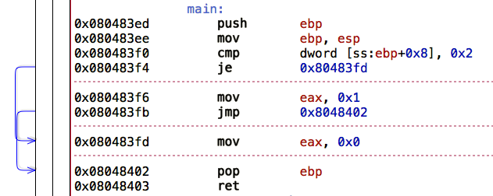
Assembly
Example

Slide 62
Assembly
AND
Logical AND - ‘&’
Source can be register, immediate or memory
Destination can be register or memory
1 & 1 = 1
1 & 0 = 0
0 & 1 = 0
0 & 0 = 0

Slide 63
Assembly
OR
Logical OR – ‘|’
Source can be register, immediate or memory
Destination can be register or memory
1 | 1 = 1
1 | 0 = 1
0 | 1 = 1
0 | 0 = 0

Slide 64
Assembly
XOR
Logical Exclusive Or – ‘^’
Source can be register, immediate or memory
Destination can be register or immediate
1 ^ 1 = 0
1 ^ 0 = 1
0 ^ 1 = 1
0 ^ 0 = 0

Slide 65
Assembly
NOT
Flips the bits – One’s compliment
Single source/destination operand can be register, immediate or memory
Notes:
- One’s compliment is simply flipping all the bits

Slide 66
Assembly
What we know so far
NOP
PUSH/POP
CALL/RET/LEAVE
MOV/LEA
ADD/SUB
JMP/Jcc
CMP/TEST
AND/OR/XOR/NOT

Slide 67
Assembly
LOOPS
Identify the initialization of the loop counter variable
Identify the limit of the loop
Identify the increment/decrement

Slide 68
Assembly
Example
#include <stdio.h>
int main(int argc, char* argv[]){
int i;
for (i = 0; i < 10; i++){
printf("Looping %d\n", i);
}
}

Slide 69
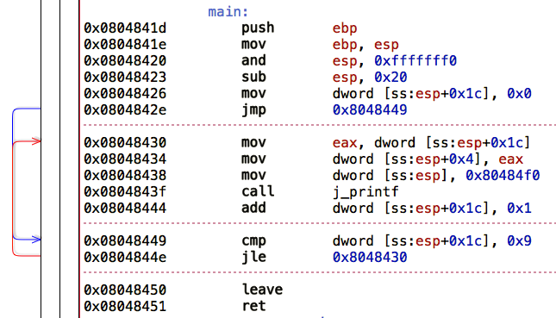
Assembly
Identify the initialization of the loop counter variable

Slide 70
Assembly
Identify the limit of the loop

Slide 71
Assembly
Identify the increment/decrement

Slide 72
Assembly
SHL
Shift Logical Left – ‘<<‘
Destination operand can be register or memory
Source operand can be CL (lowest byte of ECX) or 1 byte immediate
It multiplies the destination operand by 2 for each bit shifted
Bits shifted off the left side of the operand set the carry flag
00110011 << 2 = 11001100 with CF = 0
01100110 << 2 = 10011000 with CF = 1

Slide 73
Assembly
SHR
Shift Logical Right – ‘>>’
Destination operand can be register or memory
Source operand can be CL (lowest byte of ECX) or 1 byte immediate
It divides the destination operand by 2 for each bit shifted
Bits shifted off the right side of the operand set the carry flag
00110011 >> 2 = 00001100 with CF = 1
01100100 >> 2 = 00011001 with CF = 0

Slide 74
Assembly
IMUL
Signed Multiply
Three forms
imul r/m32 edx:eax = eax * r/m32
imul reg, r/m32 reg = reg * r/m32
imul reg, r/m32, imm reg = r/m32 * imm
Notes:
- Explain r/m32 meaning REGISTER or MEMORY operand

Slide 75
Assembly
MUL
Same as IMUL but unsigned

Slide 76
Assembly
DIV
Unsigned Division
Two forms:
div AX by r/m8
AL = quotient, AH = remainder
div EDX:EAX by r/m32
EAX = quotient, EDX = remainder
Division by 0 raises an exception

Slide 77
Assembly
IDIV
Same as DIV but signed

Slide 78
Assembly
REP STOS
Repeat Store String
REP is standalone repetition instruction
STOS is also standalone instruction
Uses ECX as a counter
Can move a byte or dword at at time
Moves byte AL into [EDI] or dword EAX into [EDI]
Increments EDI register by 1 or 4
Pre-requisites:
Set EDI to the destination address
Initialize EAX with value to store
Initialize ECX as counter
Notes:
- All REP instructions use ECX as a counter

Slide 79
Assembly
REP MOVS
Repeat Move Data String to String
Same as REP STOS but instead of storing a single byte/dword from EAX we can copy data from source to destination via ESI as source operand and EDI as destination operand
Each loop increments ESI, EDI and decrements ECX
REP MOVS DWORD PTR [ESI], DWORD PTR [EDI]
Pre-requisites:
Initialize ESI with the address of the data source
Initialize EDI with the address of the data dest
Initialize ECX as the counter

Slide 80
Assembly
NEG
Negate – Performs two’s compliment
Single operand can be r/m32
Two’s Compliment = Flip the bits and add 1
Turns positive to negative and vice versa

Slide 81
Assembly
What we know so far
NOP
PUSH/POP
CALL/RET/LEAVE
MOV/LEA
ADD/SUB
JMP/Jcc
CMP/TEST
AND/OR/XOR/NOT
SHL/SHR
MUL/IMUL
DIV/IDIV
REP STOS
REP MOVS
NEG
LOOPS

Slide 82
Assembly
Example
#include <stdio.h>
int main(int argc, char* argv[]){
int int_array[5] = {0x5, 0x10, 0x15, 0x20, 0x25};
int i;
for (i = 0; i < 5; i++){
printf("Int at index %d is %d\n", i, int_array[i]);
}
}
Notes:
- Array access

Slide 83
Assembly
Example
Array access is always
Base address + offset element (index element) * (times) scale (size of each element of the array)
Notes:
- Array access

Slide 84
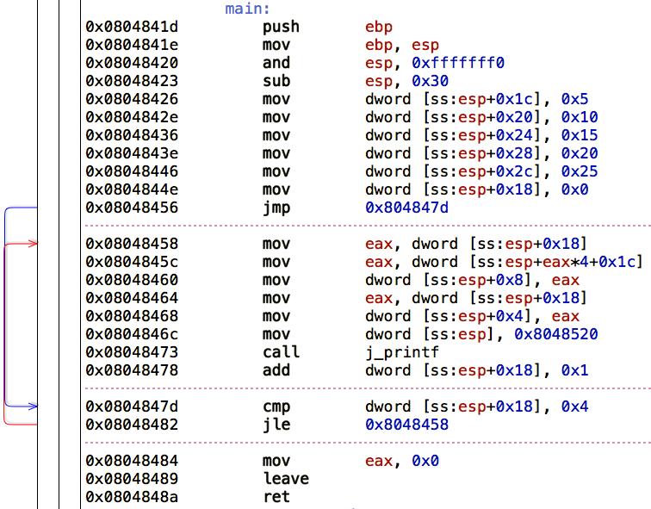
Assembly
Notes:
Array access
Base+offset*scale

Slide 85
Calling Conventions
What are calling conventions ?
How arguments are passed to functions

Slide 86
Calling Conventions
What are calling conventions ?
How arguments are passed to functions

Slide 87
Calling Conventions
What are calling conventions ?
How arguments are passed to functions
Who cleans the stack
Return values

Slide 88
Calling Conventions
CDECL
C Declaration
Arguments are pushed to the stack right to left – meaning the first argument will be on top of the stack
Return value is stored in EAX or EDX:EAX
Caller is responsible for cleaning the stack – meaning cleaning up the arguments pushed
Notes:
- Caller is the outer function that calls the callee function

Slide 89
Calling Conventions
STDCALL
Standard Call
Arguments are pushed to the stack right to left – meaning the first argument will be on top of the stack
Return value is stored in EAX
Callee is responsible for cleaning the stack – meaning callee function is responsible for cleaning up the arguments pushed by the Caller function
Notes:
- Caller is the outer function that calls the callee function

Slide 90
Debuggers and Disassemblers
Decompilers
Opposite to compiler, takes compiled binary as input and produces high level source code.
Hex-Rays Decompiler ~$3,000 per architecture
The Hopper ~$80
Free - https://retdec.com/

Slide 91
Debuggers and Disassemblers
Disassemblers
Translates machine language into assembly language
Static Analysis – The binary application is not executed
IDA Pro – The Interactive Disassembler
The Hopper
Objdump
Notes:
- Opposite of assemblers

Slide 92
Debuggers and Disassemblers
Disassemblers Hotkeys
space – Switch between linear view / graph view
n – name a variable/function/argument
g – Go to address
x – Cross reference
esc – Go back to the previous location / Move out of a function
d – Convert code to data or change the data type from byte/word/dword/qword
c – Convert data to code
p – Define a procedure
u – Undefine a procedure
; – Set a comment

Slide 93
Debuggers and Disassemblers
Debuggers
Can disassemble
Dynamic Analysis – Executes the binary program
GDB
OllyDbg
WinDbg
Radare2
IDA Pro
Edb

Slide 94
Debuggers and Disassemblers
GDB Commands
break <func>/*<addr> – sets a breakpoint
disassemble <func> – disassemblers a routine
x – Examine
x/2wx $esp – examine 2 words (4 bytes) in hex from ESP (top of the stack) towards EBP, UP
x/10i $eip – examine 10 instructions from EIP
x/2bx $eax – examine 2 bytes in hex from EAX
x/s $esp – examine as ASCII string

Slide 95
Debuggers and Disassemblers
GDB Commands
set $eax = 1 – set EAX to 1
set *$eax = 1 – write 1 to the address where EAX points to
info registers – display content of the registers
si/stepi – single step
ni/nexti – step over
finish – step out

Slide 96
Where to Now ?
CTFs !!!
Lena’s tutorials
Practical Malware Analysis book
CrackMe !!!
Malware
Practice Practice Practice… and more practice

